Slide 1
Academic Calendar App: Demo 2
Presenters: Allen and Vahbiz
Group Members: Harrison, Khushi, Allen, Vahbiz

Slide 2
Presentation Overview
Project Proposal
What’s new
Current Status
Where we are at now
Class Diagram
What has changed and how this effects functionality
JUnit Test
How will we know our code is working
Summary of Changes
What’s different
Class Demo
What our program can do
Future Work
What we hope to do by Demo 3

Slide 3
Updated Project Proposal
“Our plan is to create a project of the form-based application type. The general idea is to create a calendar that clearly outlines University of Calgary events and deadlines on it, and allows users to create their own events as well. For our project, ideally we would have liked to make the university events very faculty specific. However, due to time constraints and inability to use an API (as originally planned), we are using general university events instead.”

Slide 4
Current Status
Created a GUI interface that displays university events on calendar window
User can only create public events
Users can not modify or create private events
User can view all events, both those they created and those already programed
All private events (ex school fee due date, first day of classes ect) must be manually programmed

Slide 5
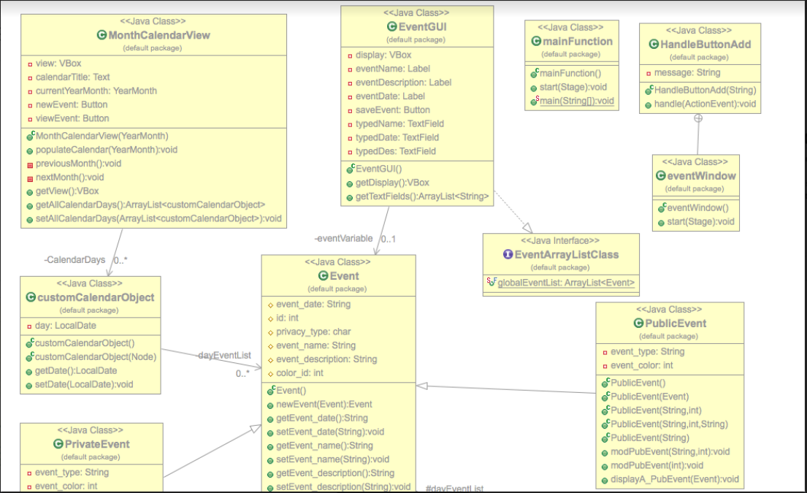
Class Diagram

Slide 6
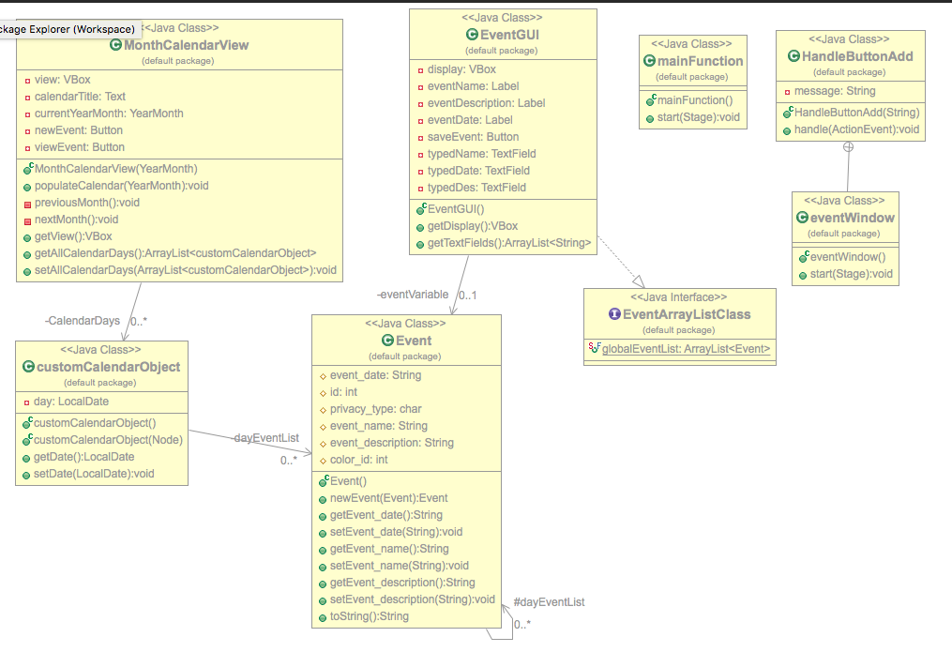

Slide 7

Code Design and Functionality
Code Design and Structure
MonthCalendarView and EventGUI classes are used as medium between java. functions and classes we created in the project
ActionEvent was programed directly into code (as opposed to using a separate class) to minimize the confusion of scope and allow us to directly link each button with a custom function
Functionality:
minimalist design
Can create new event that is saved to array list

Slide 8
Junit Test
Adding new event to Event List and checking that it appears in the event ArrayList
Adding empty event and check if empty event is getting saved
Adding mix of uppercase and lowercase in both event name and event description and check if the program will take the input
Adding different format of date and check if the program will recognize the correct date.
Adding date format that is not in the system and check if the program will reject the input and ask user to input again

Slide 9
Changes from Demo 1
Custom Class Added
Built GUI and integrated with previously presented code
Day, Month, Public and Private Event Classes removed
Notes:
The custom class was used to convert format from user input to the format that is being used in the program. So later on, user could input several format instead of one.
GUI here is a big difference from demo 1, we will have to still utilizing the text-based code for taking event and store in the event arraylist. Then we use the GUI to display the calendar and create button for user to save event in the system.
Day, Month, Public and Private Event are removed from demo1 as we are going to hard code the school event and faculty event into event list and no one will be able to change it. User can now only create personal event. And we figure out that use a double for loop to generate the view for each month and day, month object are no longer for display purpose.

Slide 10
Challenges
Populate the calendar
next/previous month button clicked
Events creation in the GUI
One button vs buttons on each day object
JUnit Test
use as much case as possible to break down the code
Custom Class
figuring out how to connect user input and calendar functions through intermediate class
Notes:
*Populate the calendar: orginally was to detect the end day of each month and go from there, now we are dectecting every Sunday of the week and put that week into the calendar view, so whenever the nextMonth/previousMonth is clicked, we will try to find the next Sunday of the week.
Event Creation: originally intend to have button on every day object and create event from there, but now we decide to simplify the design with just one button to create event at any date you want.
Junit Test: when you write the program, you do not notice where the bug may come from, therefore we will need someone who is not familiar with the code but functionality to test everything he could think of to break the function from running.
Custom Class: since different library have different format for date, we will have to look into the default setting and try to convert input string to any format that will make the library work.

Slide 11
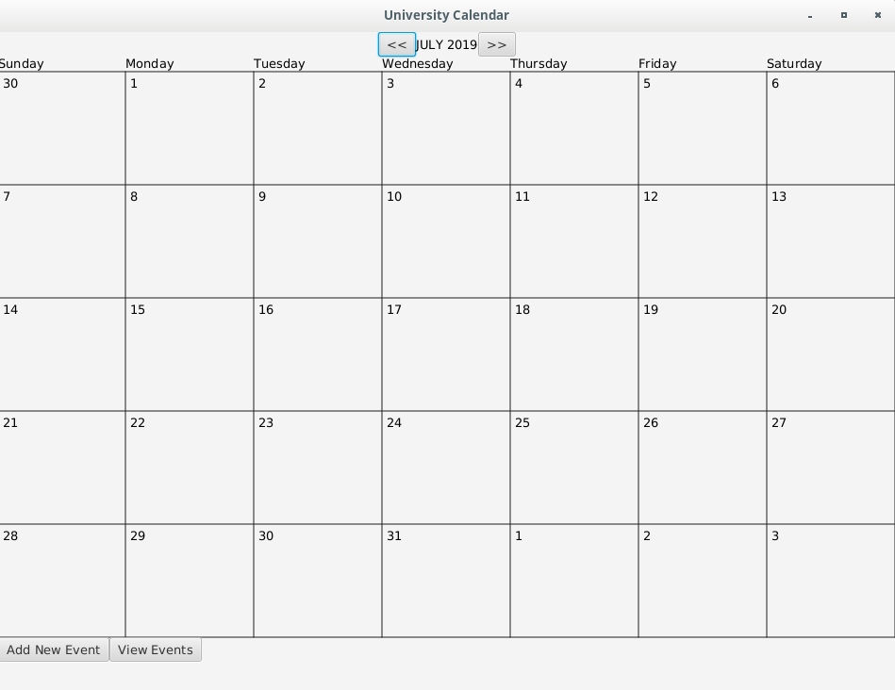
Project Demonstration

Slide 12
Future Work
Adding in-app/email notification
Different Events will have different color representation
Prepare more months in calendar
Incorporating Faculty events (particularly from CPSC)
Compatible with Google Calendar (import & export)

Slide 13
Thank you!

